Slide 1



Macrosystems EDDIE: Introduction to Ecological Forecasting
Moore, T. N., Carey, C.C., Thomas, R. Q. 23 January 2021.
Macrosystems EDDIE: Introduction to Ecological Forecasting.
Macrosystems EDDIE Module 5, Version 1.
http://module5.macrosystemseddie.org
Module development supported by NSF DEB-1926050; NSF DBI-1933016
Notes:
Welcome the students to class.
It is important at this point to emphasize that there will be lots of new material covered.

Slide 2
Overview of today
Introducing the concepts of ecological forecasting, forecasting applications, and the iterative forecast cycle
Activity A: Get data from an ecological site and build an ecological model to simulate ecosystem productivity
Activity B: Step through each stage of the forecast cycle and generate an ecological forecast
Debrief as a group: mini-presentations from lake pairs
Activity C: Compare how ecosystem productivity forecasts differ among sites from different climatic regions
Notes:
Quick road map of what will be covered in this lesson

Slide 3
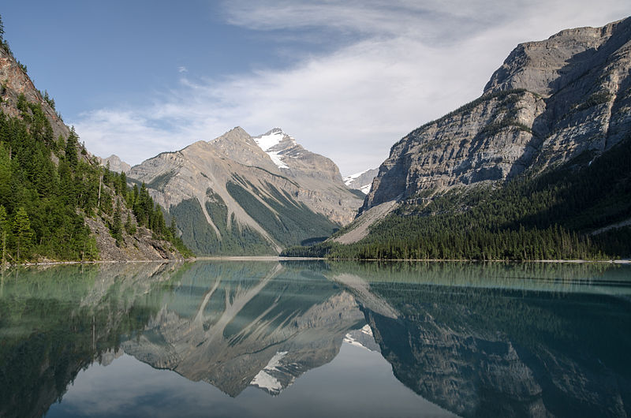
Ecosystems are changing worldwide…
In response to changes in the climate and land use, aquatic and terrestrial systems are experiencing different pressures which affect productivity
Lakes and reservoirs are key providers of ecological services and understanding how they will change in the short-term is critical to help management of these resources
Image: Wikimedia commons
Notes:
Big picture, framing ecological forecasts in the context of changing climate and land use.
Focus on aquatic ecosystems today, management of these resources could be improved my having advance knowledge of how they could potentially change.
Why do we want to generate ecological forecasts?
Answer: Because there is lots of variability in how climate change is occurring globally and lakes provide critical ecosystem services for humans, so ecological forecasts are critical to help management of these resources in the short-term.

Slide 4
Before we start:
What is a Forecast?
“A forecast is a prediction of a future event with uncertainty”
Events have not yet occurred
Gives a probability or a likelihood of the event to occur (uncertainty)
Actionable
Notes:
Ask the class “What is a Forecast?” –
if teaching virtually, prompt them to either type answers into the chat or raise their hand to ask the question.
Key aspects of a forecasts are listed in the slide.
Actionable implies that the information is given in a time frame that allows for a response. For example, you could forecast air temperature five minutes into the future with relatively low uncertainty, but this is not much use compared to a forecast for air temperature five days into the future.

Slide 5
Before we start
What do we Forecast?
Weather
Floods
Hurricanes
Forest fires
Economy
Disease transmission
Election results
Greenhouse gas emissions
Earthquakes
Land use
Player and team performance in sports
Sales
Transport planning
and much more!
Notes:
Ask the class ‘What do we forecast?’.
Encourage them to provide answers by either un-muting or typing into the chat or raising their hand.
Add the examples with the animation and detail how forecasting is prevalent across many different sectors of society.

Slide 6
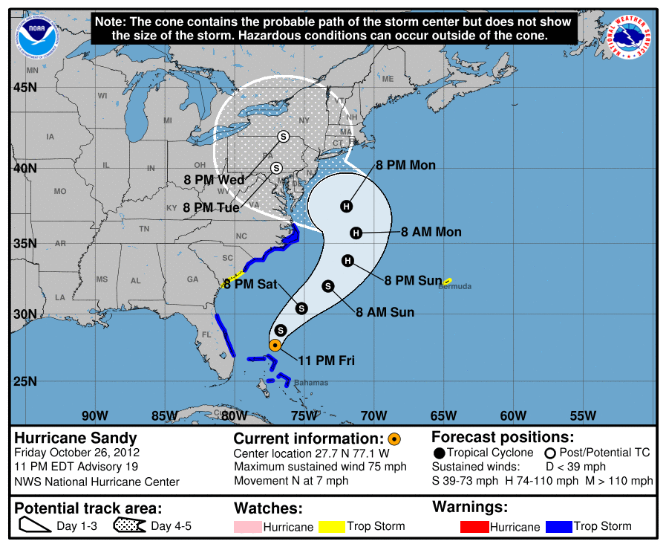
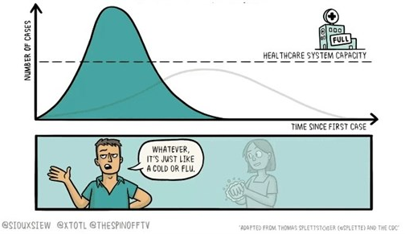
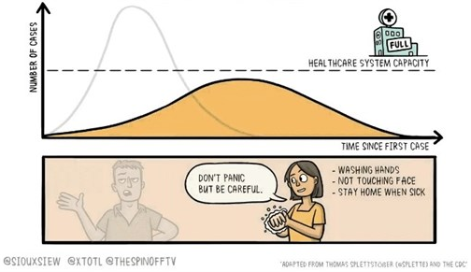
What is the purpose of a forecast?
Preparation
e.g. weather forecast - hurricanes
Action
e.g. disease forecasting, fire forecasts
Notes:
There are two main purposes of forecasts.
Talk through the examples and stress the difference between a situation when we have no control over the outcome (passive) and when we can influence the outcome (active)
Preparation – the example is Hurricane Sandy in 2012 - passive
Actionable – the example is COVID-19 - active

Slide 7
Our focal question:
What is an Ecological Forecast?
“Prediction of future environmental conditions
with uncertainty”
Notes:
Today, we are going to focus specifically on ecological forecasting.
Question to ask the students on this slide: what is an ecological forecast?
Highlight the inclusion of “uncertainty”

Slide 8
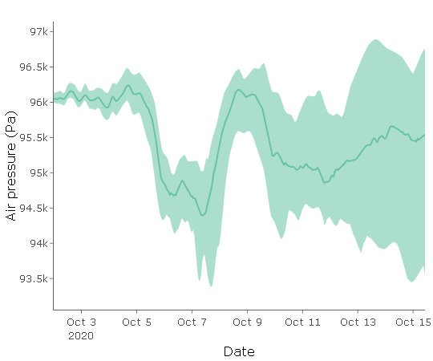
Uncertainty
A forecast is a well-informed guess of the future; therefore, it will always be uncertain
It is at the core of how people evaluate risk and make decisions
Uncertainty generally increases with time into the future
Plot showing 16 day forecast of air pressure with shaded regions showing 95% confidence interval and the solid line represents the median
Notes:
Uncertainty:
A forecast is a well-informed guess of the future; therefore, it will always be uncertain
It is at the core of how people evaluate risk and make decisions
Uncertainty generally increases with time into the future
Here is a plot showing 16 day forecast of air pressure with shaded regions showing 95% confidence interval and the solid line represents the median. The confidence interval represents the uncertainty in the forecast.

Slide 9



?
?
Quantify Uncertainty
Generate
Forecast
The Forecast Cycle
Build Model
Communicate Forecast
?
Create
Hypothesis
Assess Forecast
Update Model
Notes:
Introduce each point in the forecast cycle and that you will break each of them down. Highlight that it is “iterative” which means that it is a repetitive process, hence why it is described as a cycle.

Slide 10
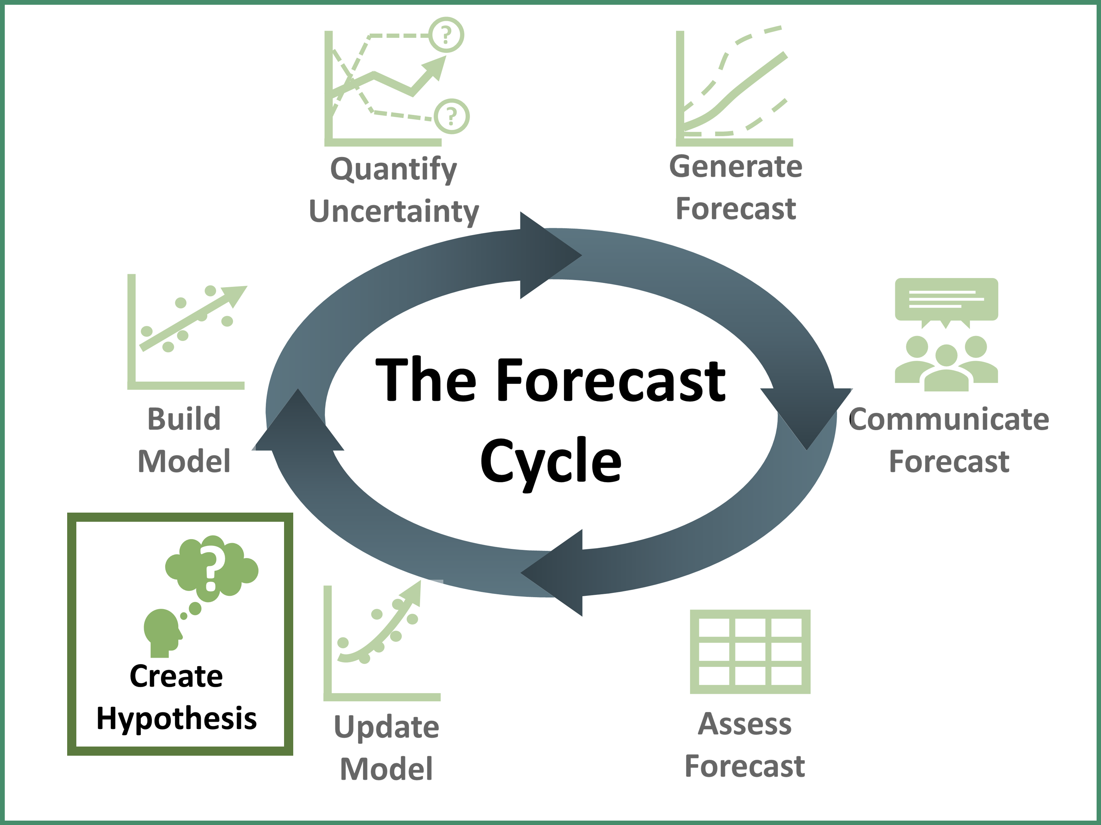
Create Hypothesis
A hypothesis is an idea that proposes an explanation about a phenomenon observed in the natural world
E.g., more nutrients will increase the algal biomass in a lake
Notes:
Create Hypothesis – use the example of how phytoplankton in a lake need nutrients to grow, so an increase in nutrients (e.g., nitrogen and phosphorus) would be expected to increase the phytoplankton biomass in a lake

Slide 11
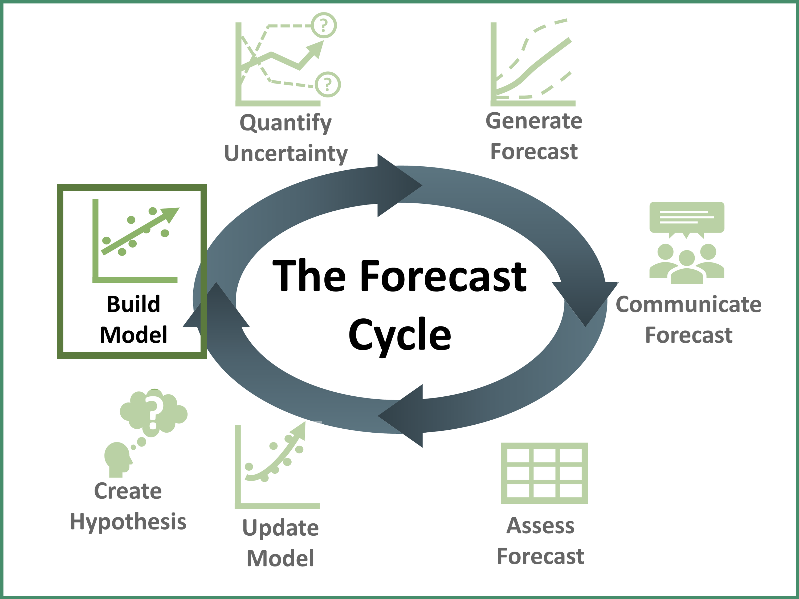

Build Model
Using observational data, we can build a mathematical model to describe what is happening
E.g.,
$${phyto}_{t}={phyto}_{t−1}+uptake −mortality$$
Amount of Phytoplankton today
Amount of Phytoplankton yesterday
Nutrient
uptake
Phytoplankton death
Notes:
Build Model – use data to build a mathematical model to describe the observations.
Driver data are variables (such as light and water temperature) which can be used to drive the model.

Slide 12
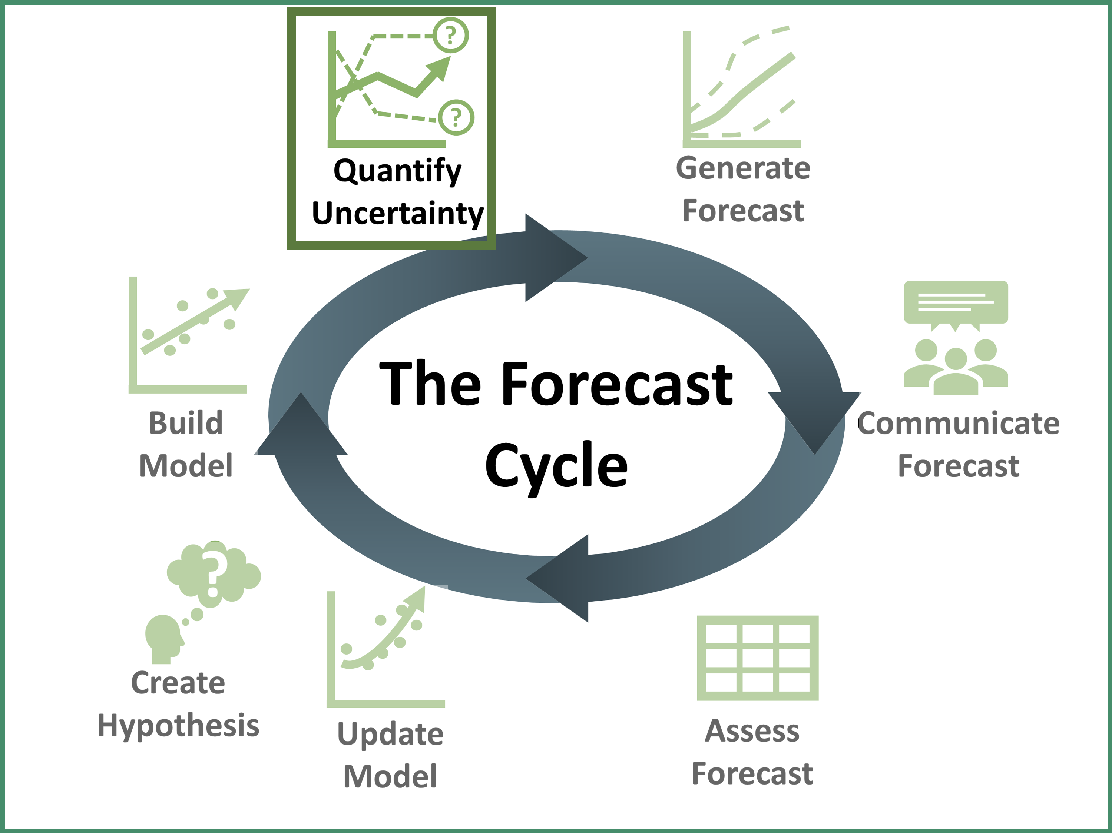
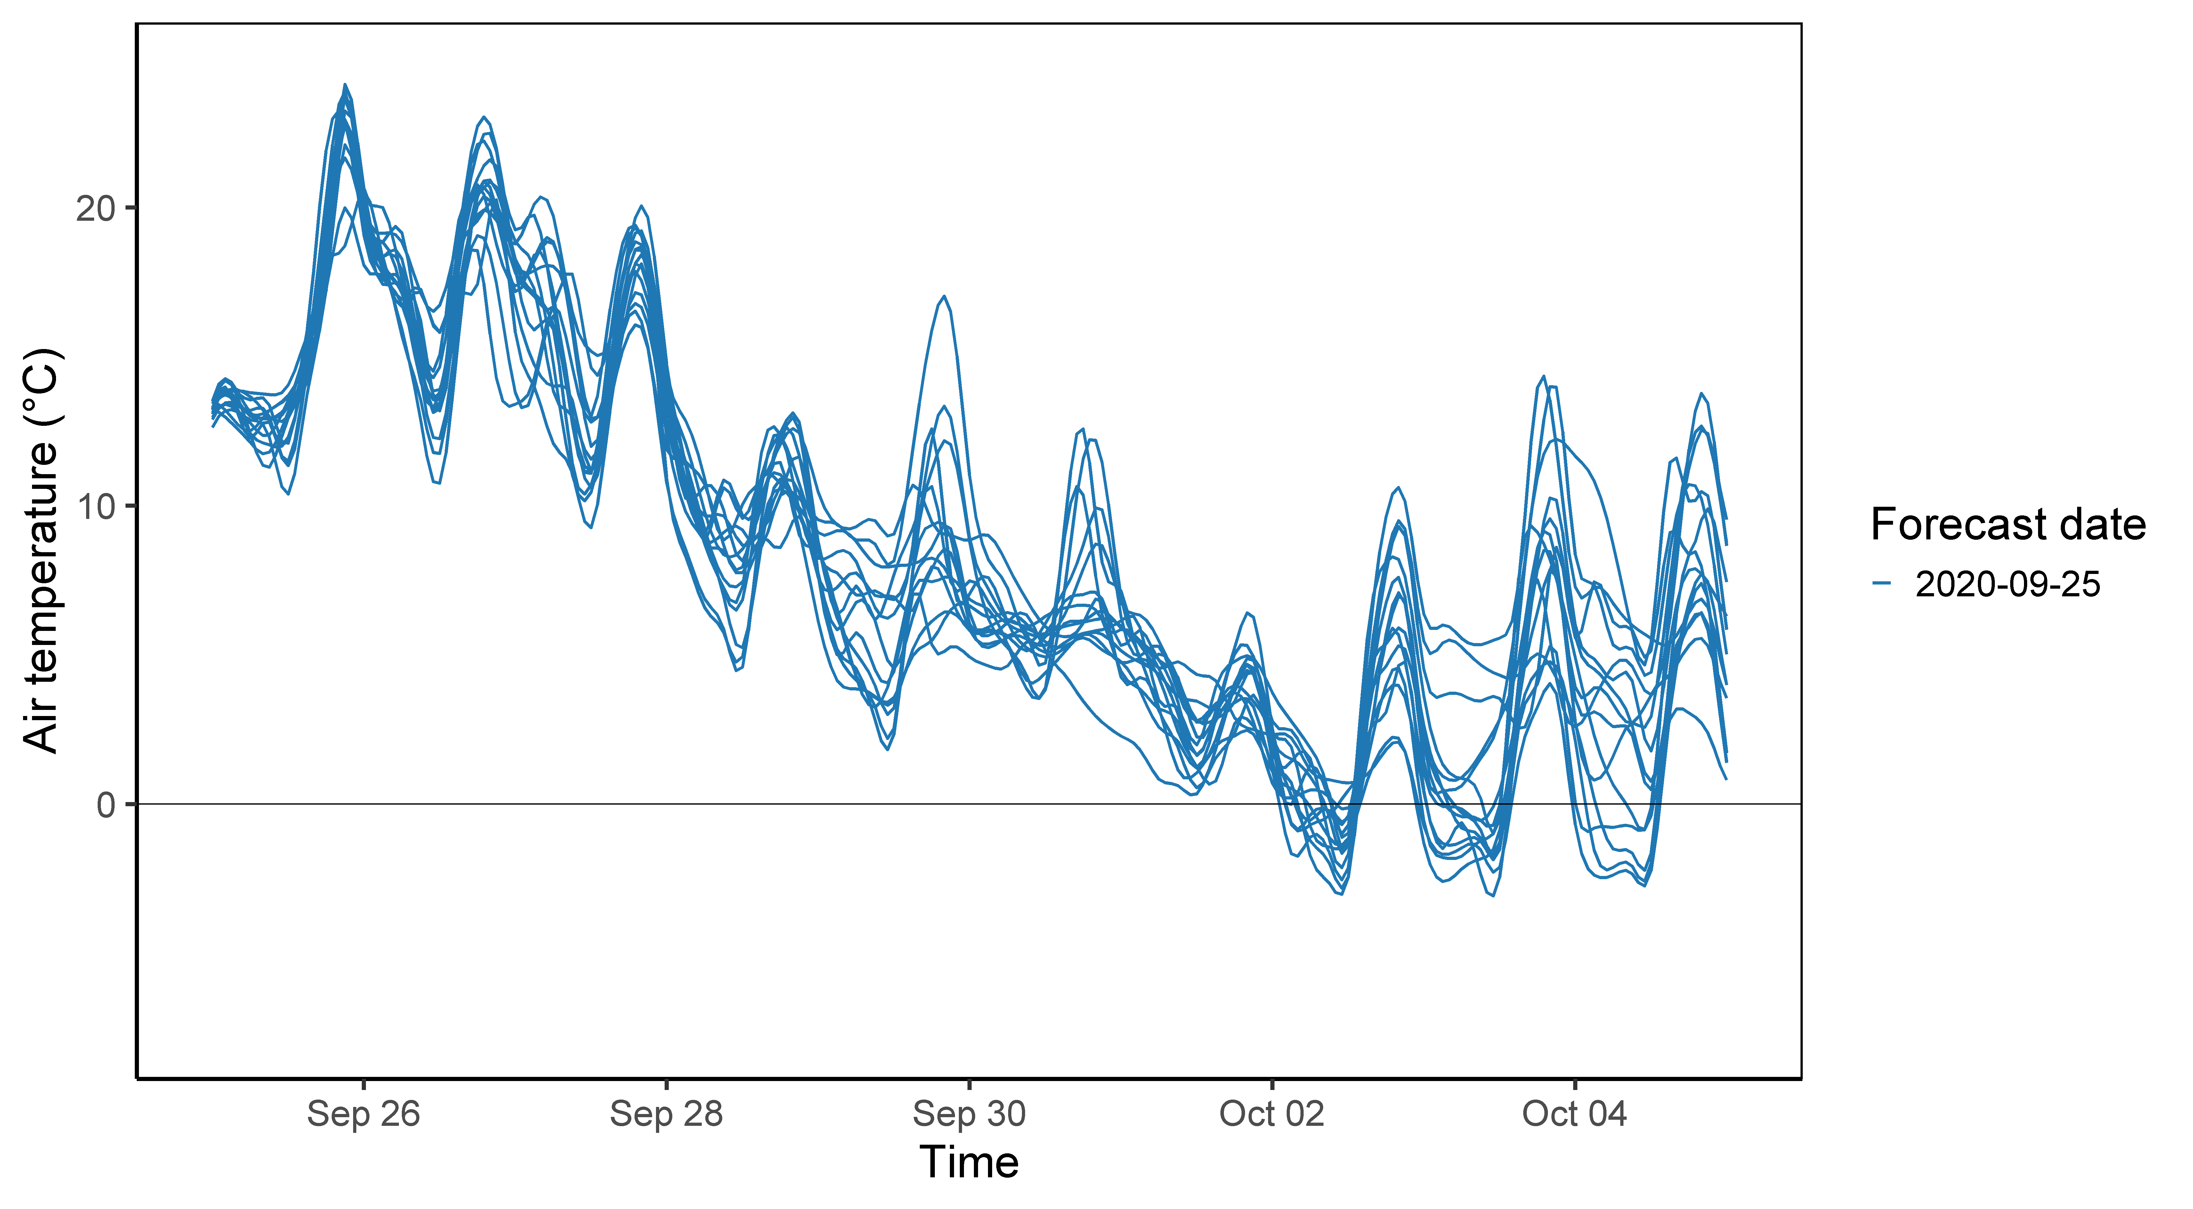
Quantify Uncertainty
Characterization and reduction of the uncertainties in the forecast
E.g., future weather isn’t known exactly, so we use many different model simulations to forecast it, and then can quantify differences among simulations as part of overall forecast uncertainty
Plot showing 10 day forecast of air temperature with each line representing a different forecast (n = 15)
Notes:
Quantify uncertainty – key step, there are also different types of uncertainty sources include: driver, model, parameter, initial conditions

Slide 13
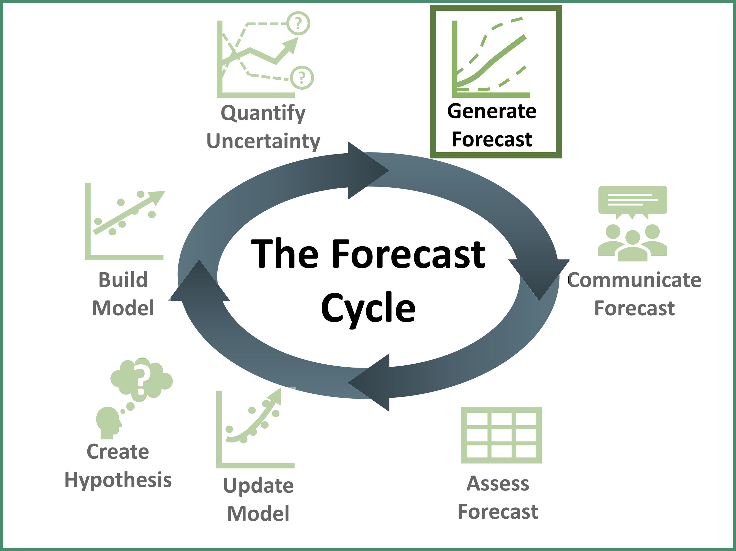
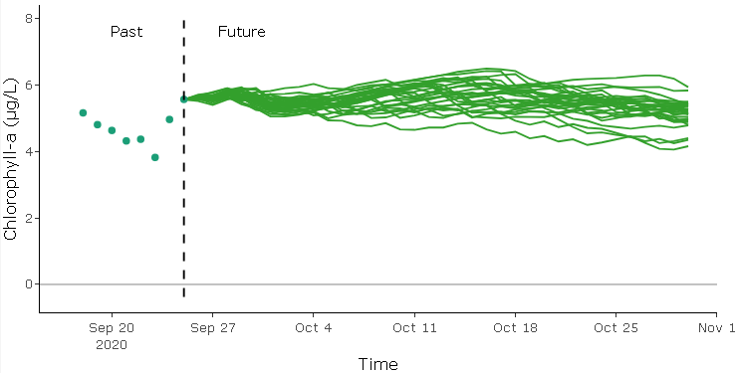
Generate Forecast
Generate a forecast into the future using the model that has been built and using forecasted driver data
Plot showing 35 day forecast of primary productivity (chlorophyll-a) with each line representing a different simulation (n = 30)
Notes:
Generate Forecast – using the model for phytoplankton concentrations, we will drive it using weather forecast data to generate an ecological forecast.
A key part of what makes a forecast is that it is driven by forecasted variables.
This example shows a forecast for primary productivity (represented as concentration of chlorophyll-a) in a lake with each line showing a different potential future. It is from this distribution of the lines that we can calculate the confidence intervals and hence the uncertainty.

Slide 14
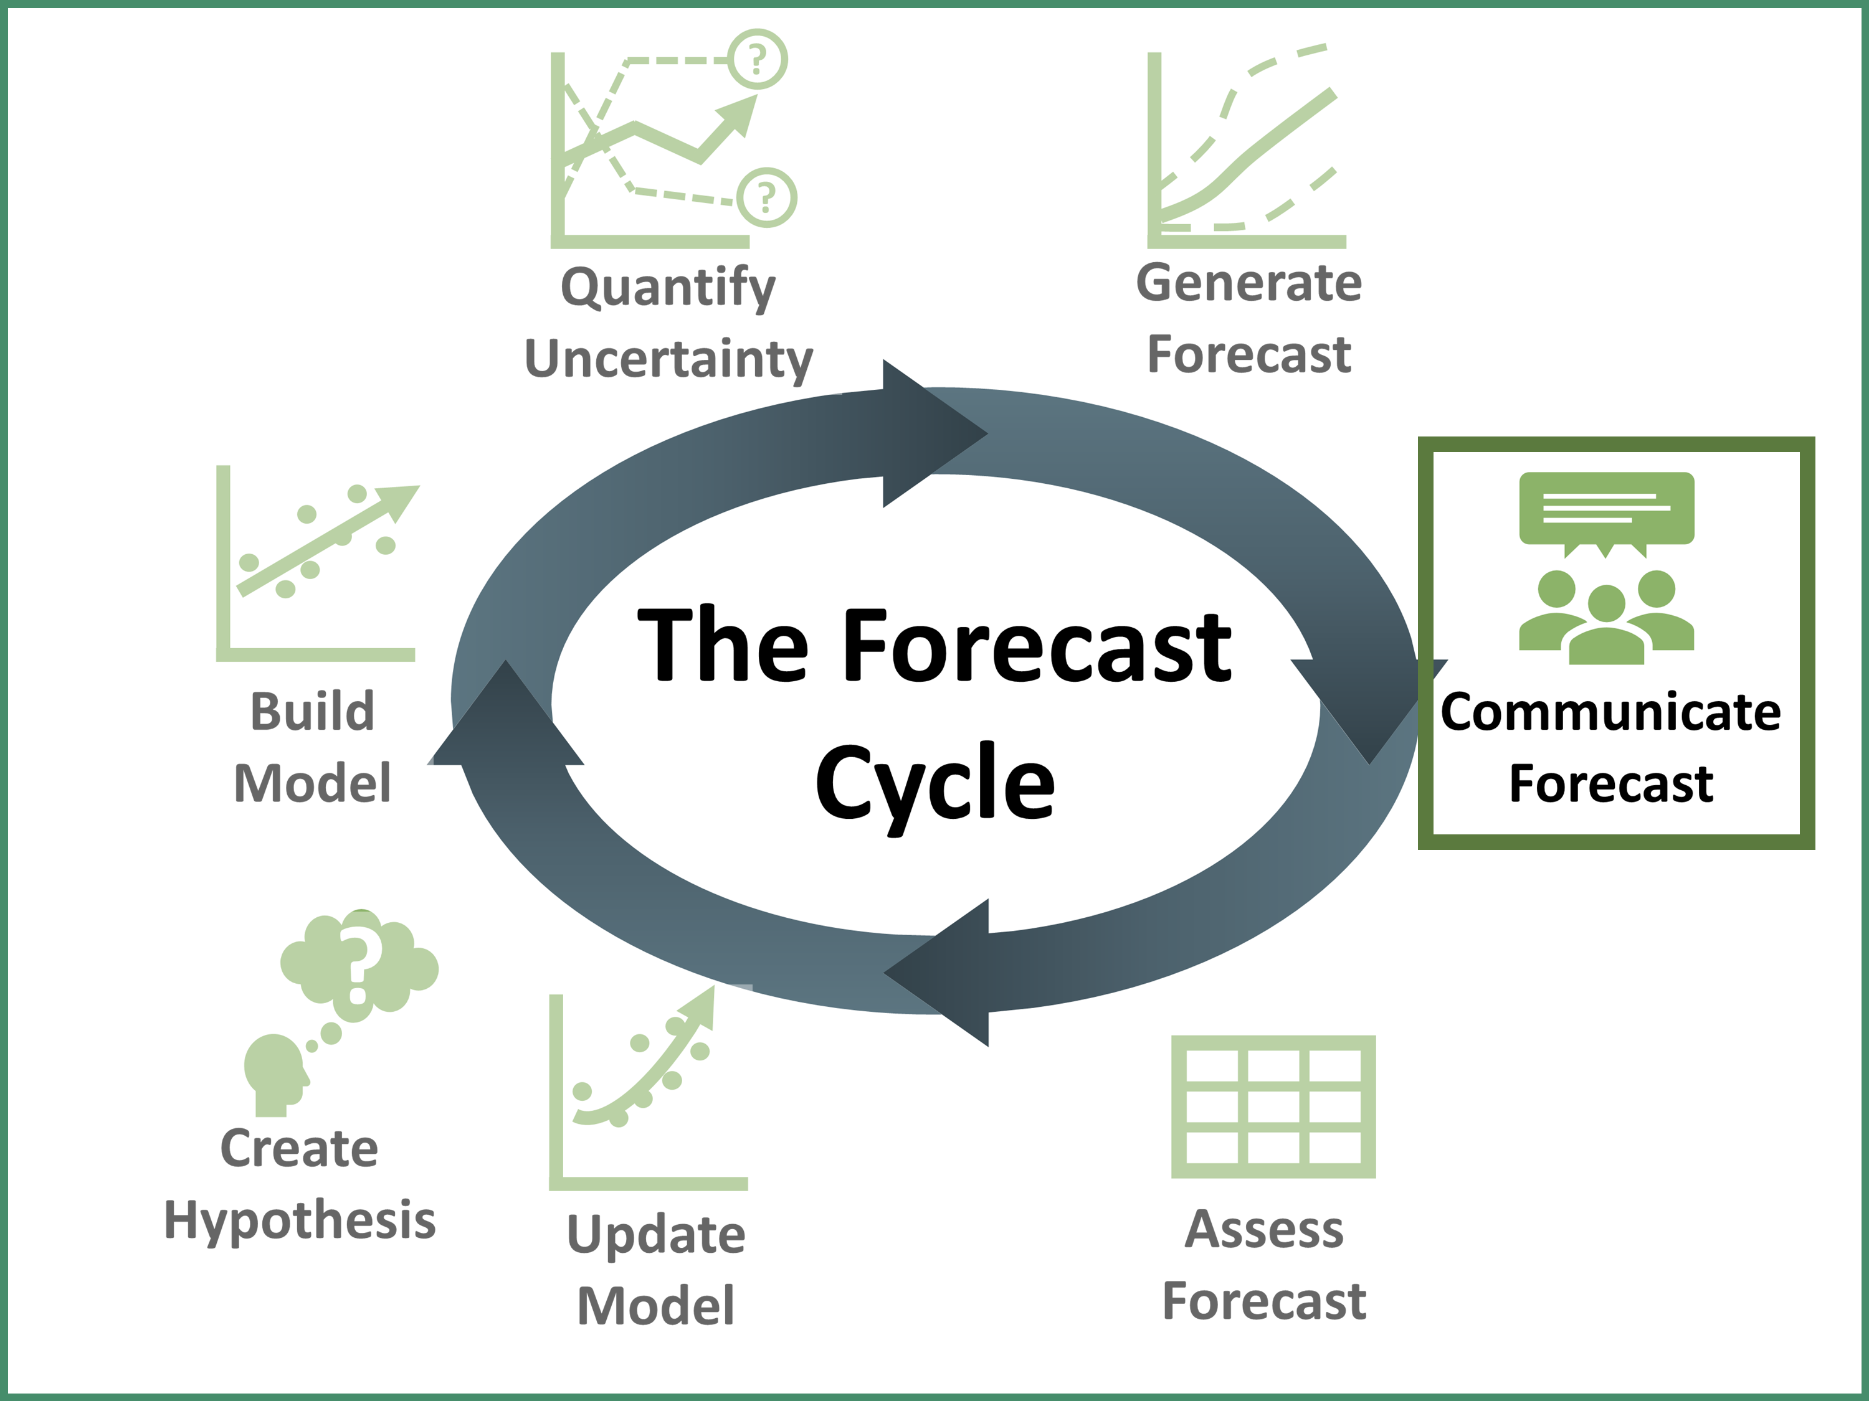
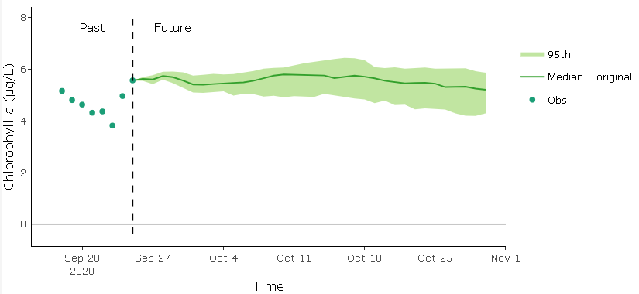
Communicate Forecast
Communicate the forecast to stakeholders and potential end-users
E.g., create visualizations of the data to aid in forecast interpretation
Plot showing 35 day forecast of primary productivity (chlorophyll-a) where the solid line represents the median and the shaded region is the 95% confidence interval (n = 30)
Notes:
Communicate Forecast – potential stakeholders being a water resource manager for a drinking water reservoir.
There are different ways to communicate a forecast, but this is a critical step as a forecast is not effective for helping management if it is not communicated effectively to end users/stakeholders.
This plot shows the distribution of the forecast where the solid line is the median and the shaded regions indicate the 95% confidence interval.

Slide 15
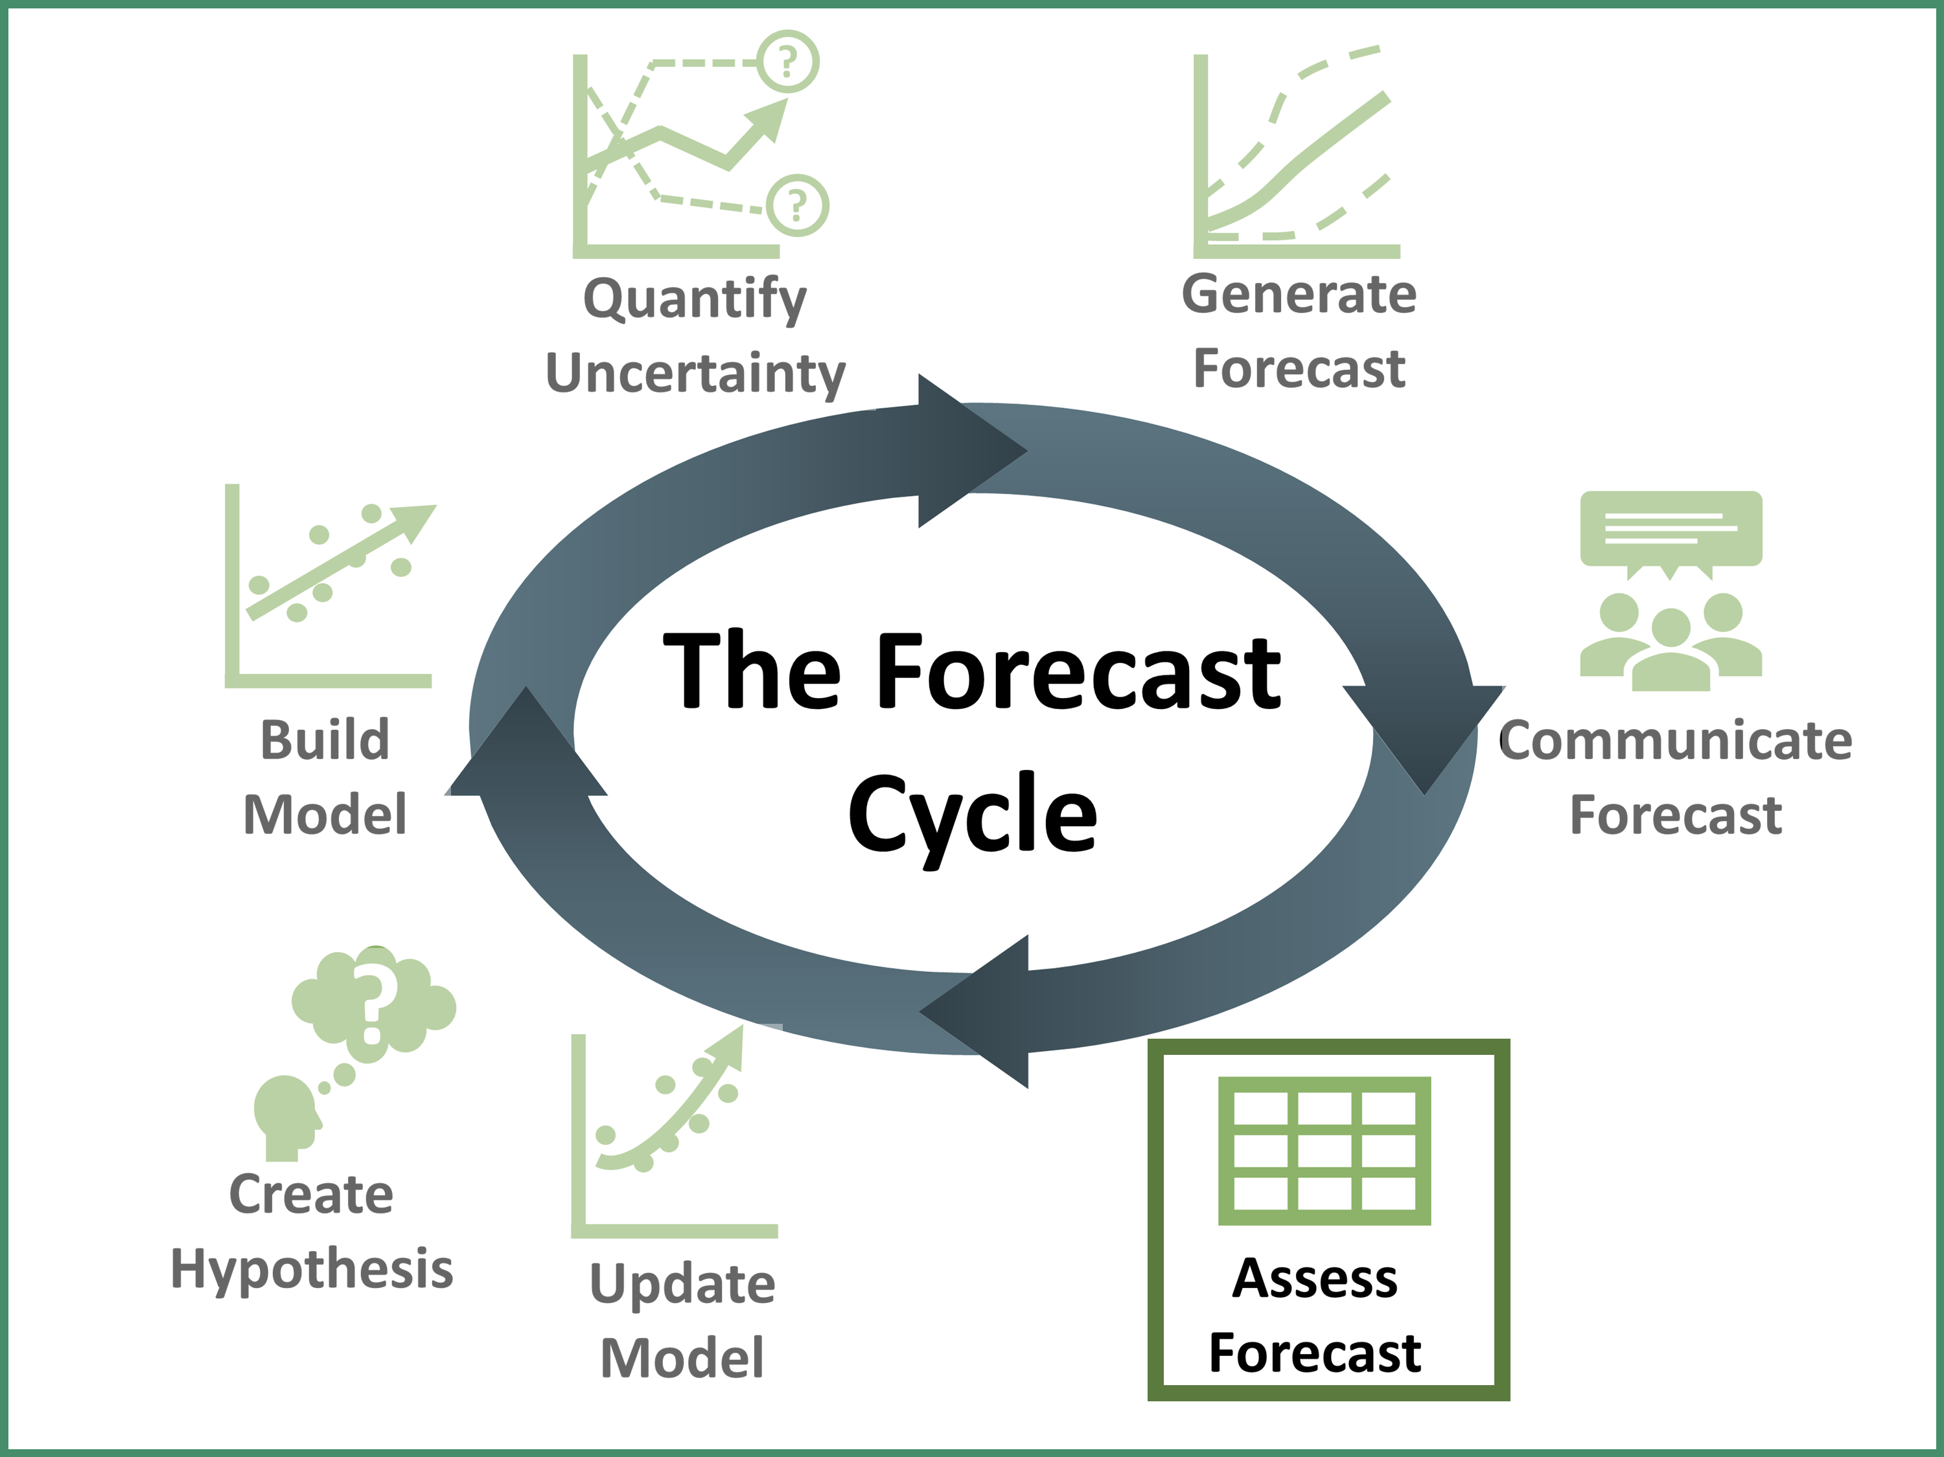
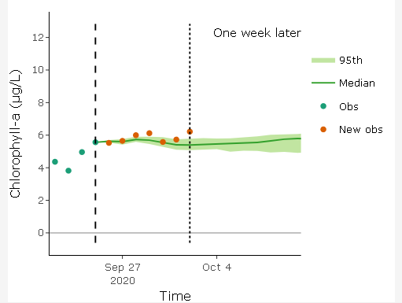
Assess Forecast
As time moves forward and new data are collected, the forecast can be compared to the data to see how well it performed
E.g., using statistical or visual measures
Plot showing the comparison of new observations (orange points) to the forecast of primary productivity (chlorophyll-a)
Notes:
Assess Forecast – Example is for chlorophyll-a, where the forecast median is represented by the solid line and the 95% confidence intervals are represented by the shaded area and observations are the orange points. Here it is predicting observed conditions relatively accurately.

Slide 16
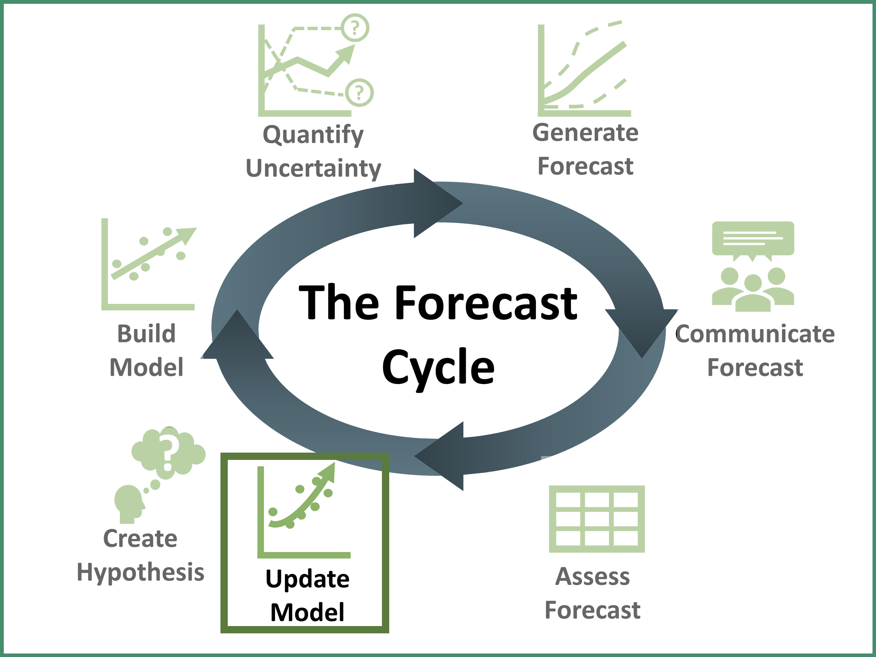
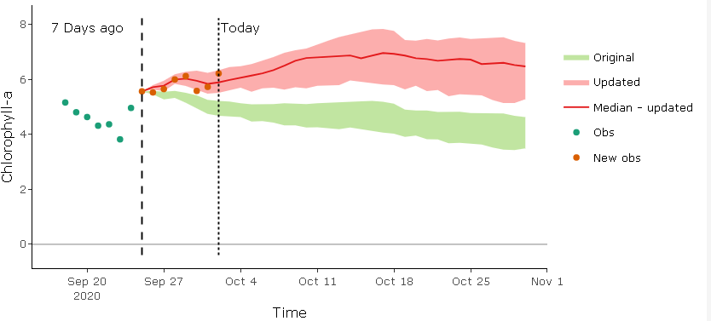
Update Model
If the forecast did not perform well vs. observations, the model can be updated before generating a new forecast
E.g., updating the model parameters
Plot showing an updated forecast (red) by updating the model parameters and the original forecast (green)
Notes:
Update model – used if model is not accurately predicting observations, can be done by updating model parameters, adding new driver variable.
For example, initially in your model you had the uptake of nutrients in your model by phytoplankton to be relatively, so you might revisit the model and decide to increase the rate of nutrient uptake within the model.
Here the example shows the original forecast (in green) and then the updated model forecast (red) which matches observations closer.

Slide 17
?
?
Quantify Uncertainty
Generate
Forecast
The Forecast Cycle
Build Model
Communicate Forecast
?
Create
Hypothesis
Assess Forecast
Update Model
Notes:
As time moves forwards you will repeat the cycle as you generate new forecasts and then update your model with new observations. This is why we call refer to the forecast cycle as “iterative”.

Slide 18


Today…
We are going to use a model to generate a forecast of primary productivity in lakes using real data
An ecological model is a simplified representation of nature, with the goal of understanding and predicting environmental dynamics
y = mx + b
Predicting chlorophyll-a concentrations in a lake
y
t
Notes:
A simple version of a model is a linear model: “y = mx + b”, but today we will be using a model to predict chlorophyll-a concentrations in a lake, where chlorophyll is the "y" in the equation but will add in other drivers such as surface water temperature and incoming light.

Slide 19
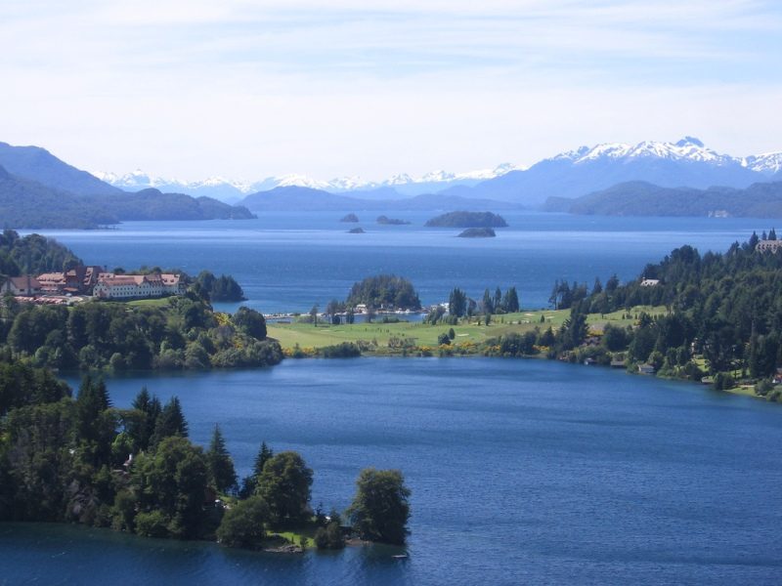
What are the drivers of primary productivity in a lake?
Light
Water temperature
Available nutrients
Phytoplankton
Zooplankton
All these factors interact to control primary productivity; you can choose in the module what drivers to include in the model!
Image: Wikimedia commons
Notes:
Primary productivity is the productivity of the photosynthesizers at the base of the food chain in aquatic ecosystems.
Phytoplankton photosynthesize in the water column by taking up nutrients and using light to convert carbon dioxide into oxygen and sugars.
Water temperature can affect the energy required to photosynthesize. Zooplankton graze on phytoplankton.

Slide 20



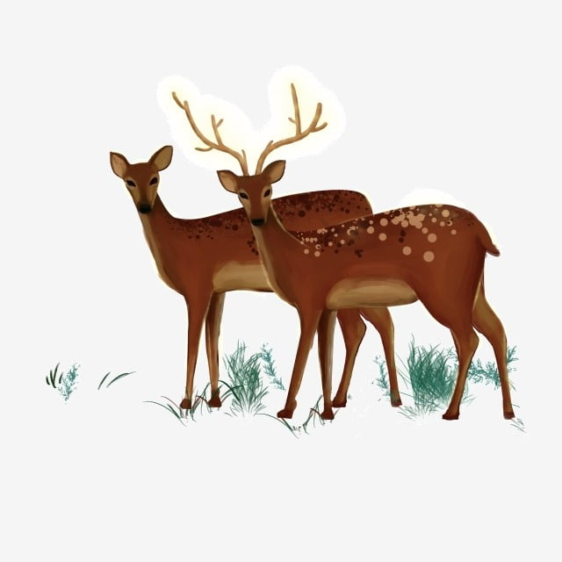

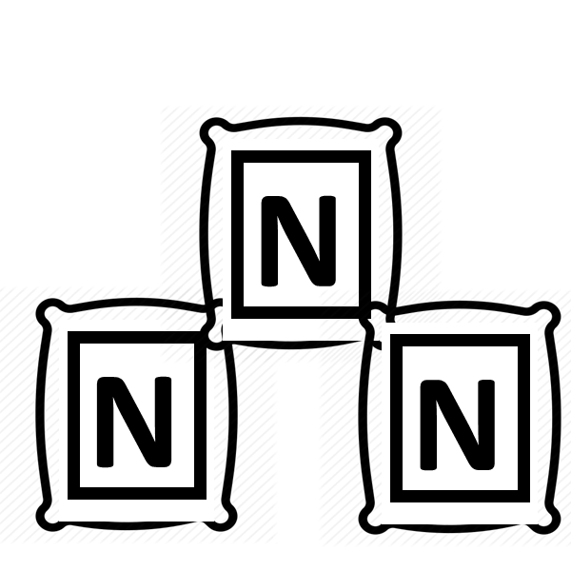
Primary Productivity Model
Terrestrial Model
Aquatic Model
Zooplankton
Phytoplankton
Deer
Plants
Producer
Consumer
Nutrients
Phosphorus/Nitrogen
Phosphorus/Nitrogen
Notes:
A primary productivity model is a simple food web model with a producer, consumer and nutrients.
For the terrestrial model, plants use sunlight to grow, deer consume the plants and then when the deer die, they decompose, and nutrients become available for plants.
For the aquatic model, phytoplankton take up nutrients from the water column and photosynthesize using sunlight, zooplankton graze on the phytoplankton, and then when they die their nutrients become available for uptake of phytoplankton.

Slide 21
Primary Productivity Model
X
Aquatic Model
Phytoplankton
Zooplankton
Producer
Consumer
Nutrients
Phosphorus/Nitrogen
Notes:
We are going to simplify the model further to just focus on phytoplankton and nutrients. So we will eliminate the consumer, zooplankton.

Slide 22

Primary Productivity Model
Simplified Version
Light
uptake
Producer
Nutrients
Phytoplankton
Nitrogen
mortality
Water temperature
Notes:
Which leaves us with the producer phytoplankton and nutrients. Phytoplankton uptake nutrients and increase in concentration and the mortality, or death of phytoplankton, increases the availability of nutrients.
For driving variables of our model, we will be using incoming light and can add in the influence of surface water temperature.
This simplified model is the “Nutrient-Phytoplankton model” or NP model.

Slide 23
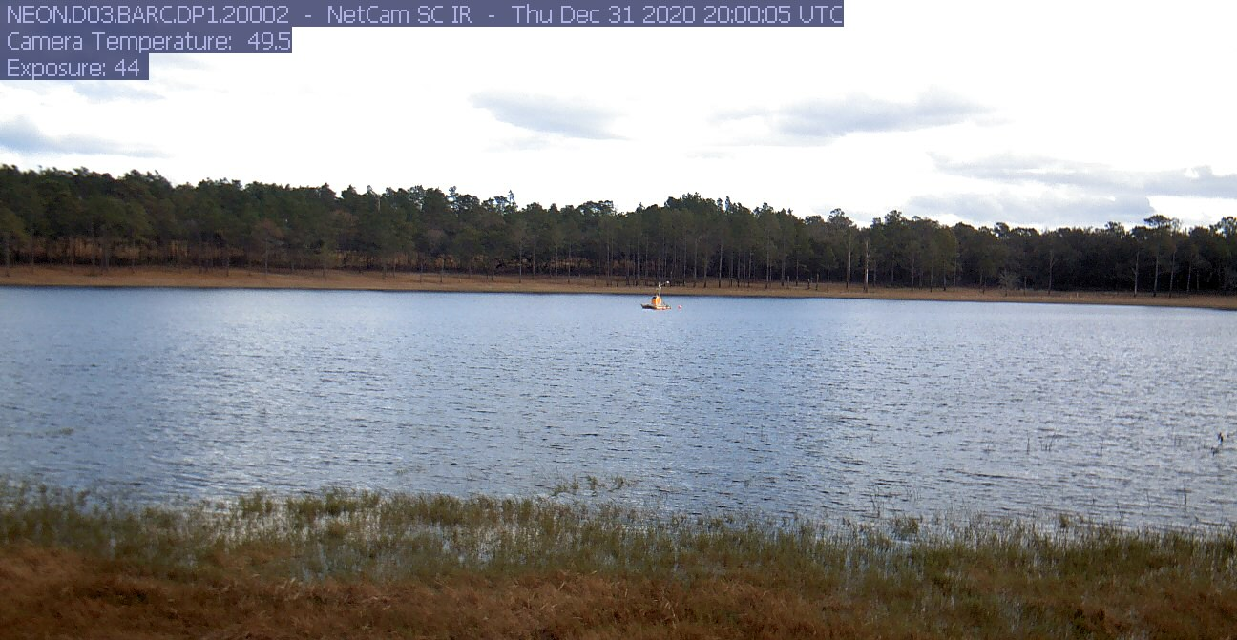
National Ecological Observatory Network (NEON)
We will be forecasting productivity at NEON sites
NEON is a continental-scale observatory designed to collect long-term open access ecological data to better understand how U.S. terrestrial and aquatic ecosystems are changing
Image: Phenocam
Notes:
National Ecological Observatory Network (NEON) is a continental-scale observatory designed to collect long-term open access ecological data to better understand how U.S. terrestrial and aquatic ecosystems are changing. Today we will be forecasting primary productivity at a NEON lake site.

Slide 24
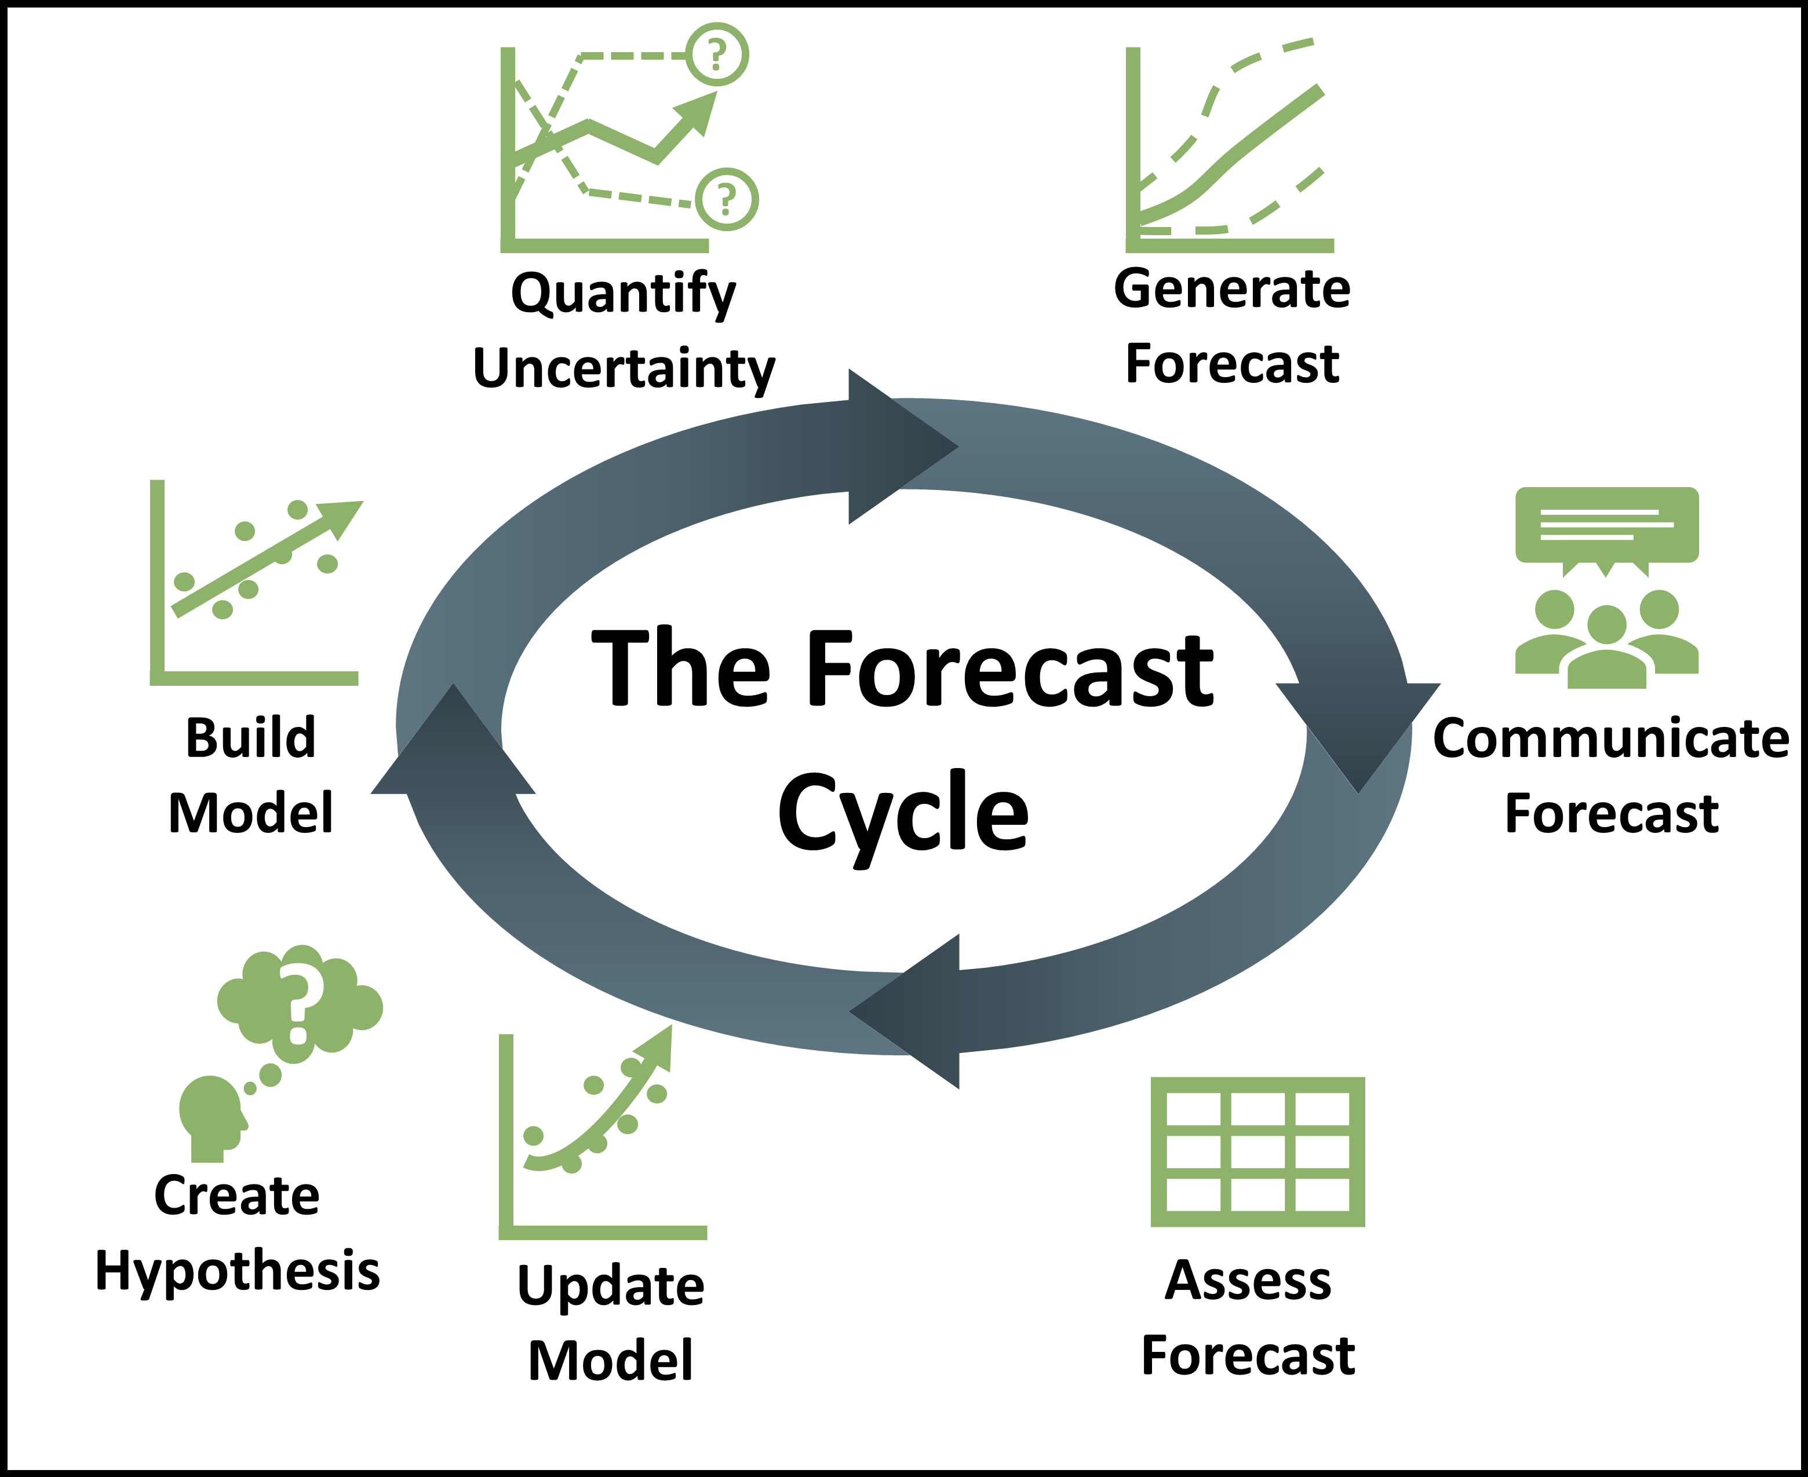
Learning objectives of today’s module:
Describe an ecological forecast and the iterative forecasting cycle
Explore and visualize NEON data
Construct an ecological model to generate forecasts of ecosystem primary productivity with uncertainty
Adjust model parameters and inputs to study how they affect forecast performance relative to observations
Compare productivity forecasts among NEON sites in different climatic regions
Notes:
Learning objectives!
Talk through these with the students one by one: use the embedded animations to sequentially show each of the six bullet points.
Most importantly, the goal here is to have students develop their own ecological model for their aquatic ecosystem, and then step through each stage of the forecast cycle.
They will then make mini-presentations to share their forecast results at the end of Activity B.

Slide 25
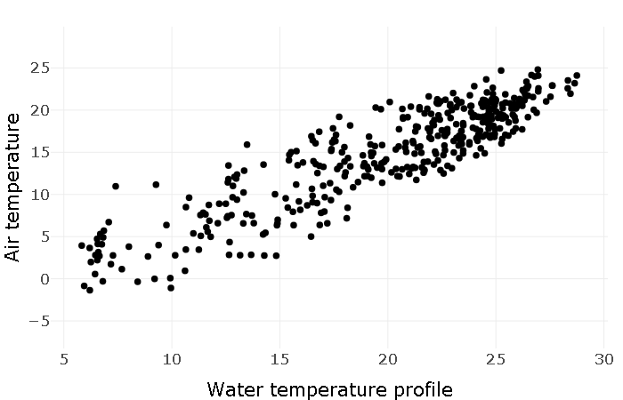
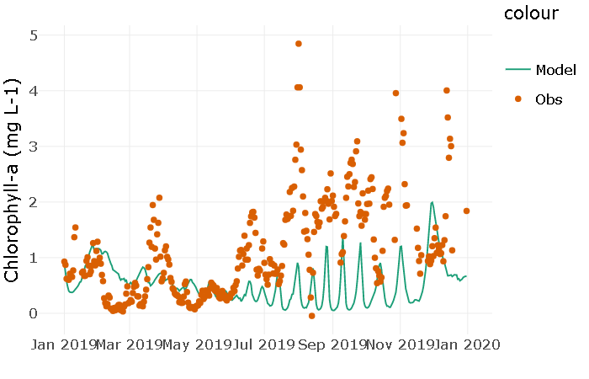
Activity A
With a partner (work in pairs):
Select a NEON site
Visualize the variables at the site
Explore variable relationships
Within pairs, each builds their own ecosystem model for their lake and compares the performance of the two different models in predicting productivity at the same site
Notes:
Introduce Activity A, which has five objectives (have students work in pairs).
Select and view a NEON site
Inspect the data
Explore variable relationships
Understand model
Build model and test scenarios

Slide 26
Activity B
With a partner (work in pairs):
Quantify forecast uncertainty
Generate a forecast of primary productivity for your site
Communicate forecast
Assess forecast with data
Update model to improve forecast
Generate the next forecast
Regroup as a class and compare how your forecast did over time
Notes:
Activity B – continue working in pairs and answer the questions individually. Step through each step of the forecast cycle
Quantify forecast uncertainty
Generate a forecast of primary productivity for your site
Communicate forecast
Assess forecast with data
Update model to improve forecast
Generate the next forecast
At the end of Activity B, regroup as a class and each of the groups present the results from their forecast and how their forecast got better or worse over time

Slide 27
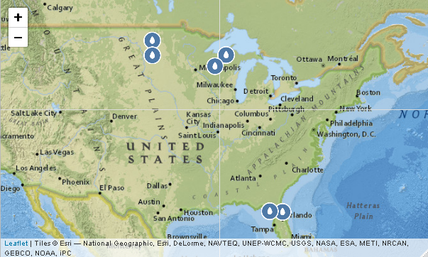
Activity C
If time/on-your-own:
Apply their ecological model to a second NEON site
Generate ecological forecasts for this second site using your initial productivity model
Notes:
Activity C – if there is time, students can repeat the forecasting activity (Activity B) with a different site.

Slide 28
Three ways to run this module
Recommended method: Shiny app website: https://macrosystemseddie.shinyapps.io/module5/
Will time out after 15 minutes, so important to save your work as you go!
Download and run the app locally from GitHub: https://github.com/MacrosystemsEDDIE/module5
Initial download requires internet but then can run module offline
Need R and R Studio installed
Last option: Binder website: https://mybinder.org/v2/zenodo/10.5281/zenodo.6587161/?urlpath=shiny/app/
Cannot support many simultaneous users
Regardless of which method you use, all options will give you the same module activities!
Notes:
The instructor may want to edit this slide beforehand to a priori ensure that students use the same method for accessing module.

Slide 29

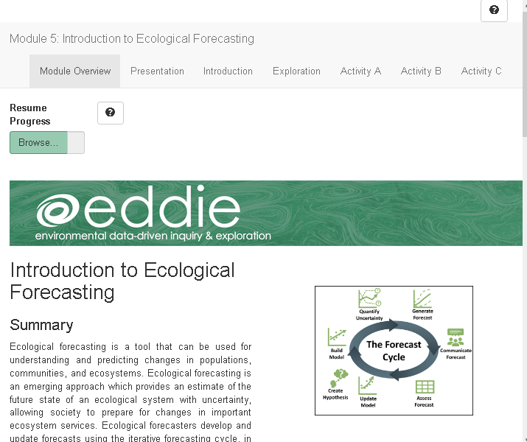
Shiny App
This is an interactive webpage built using R
It has interactive plots and options embedded which allow you to build your own personal model, visualize and explore the data, and answer questions
The module does not require writing any code in R to complete activities!
Notes:
Shiny App:
This is an interactive webpage built using R code that can be accessed multiple ways, as described on previous slide
It has interactive plots and options embedded which allow you to build your own personal model, visualize and explore the data, and answer questions

Slide 30
Let’s Go!
For the activity we will work in pairs.
Each pair selects the same NEON site and works through the Activities A & B
We will breakout into groups of 2-4 students each:
Then Activity C: make a forecast for a different lake
Lake name | Students
Crampton Lake
Barco Lake
Prairie Pothole
Little Rock Lake
Prairie Lake
Notes:
Overview slide for the day (Will require instructor edits if adapting for different class lengths!)
2 classes (1:15 -1:30 in length), completion of Activity A in class 1 and Activity B in class 2; then Activity C as homework or a 3rd class
1 class (3:00 in length), Activity A - 45mins, 5min break, Activity B – 45 mins followed by 15 min presentation/discussion of each groups results

Slide 31
Check-in:
Can you access the module via Shiny?
https://macrosystemseddie.shinyapps.io/module5/
If you do not have a stable internet connection, you can run this Shiny app locally. Go to: https://github.com/MacrosystemsEDDIE/module5 for instructions

Slide 32
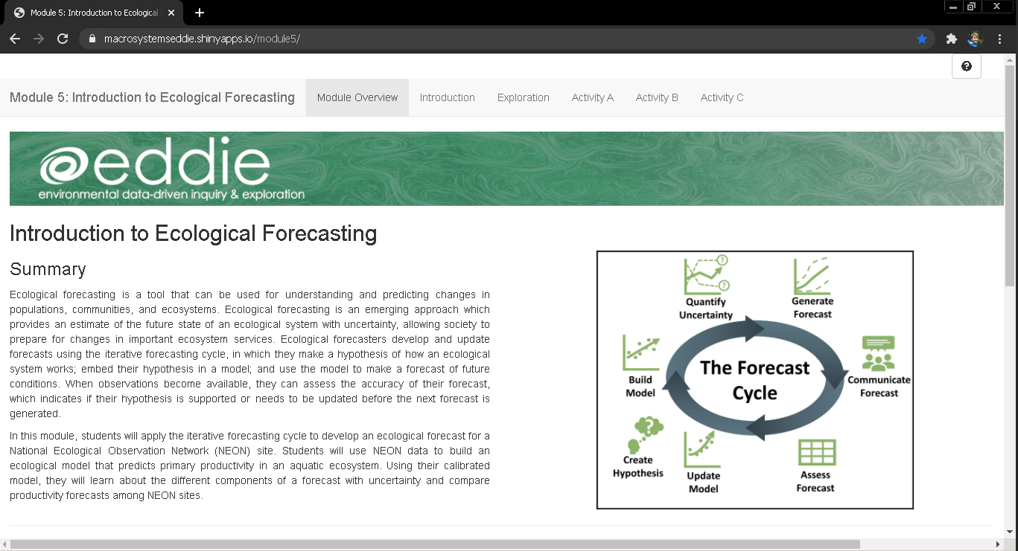
Landing Page of the Shiny App

Slide 33
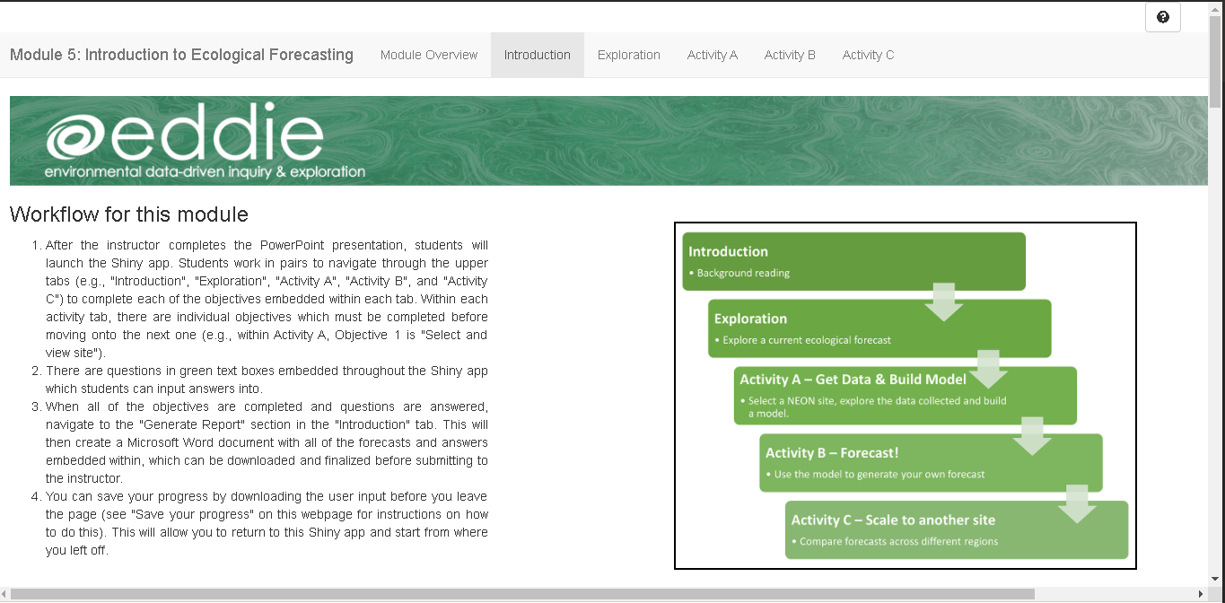

Navigating the Shiny App
Select a tab by clicking on it

Slide 34
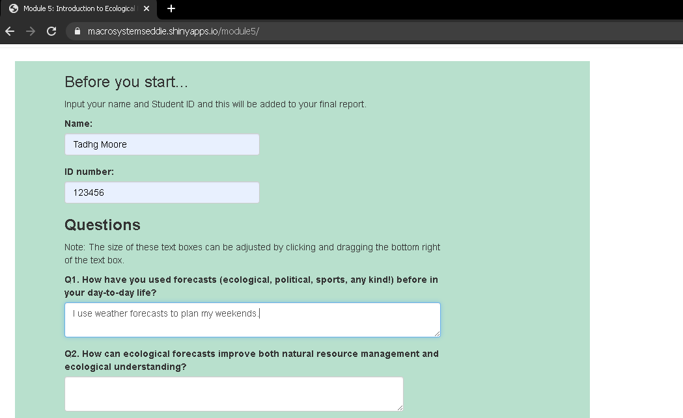
Answer questions
Type your answers into the text boxes

Slide 35
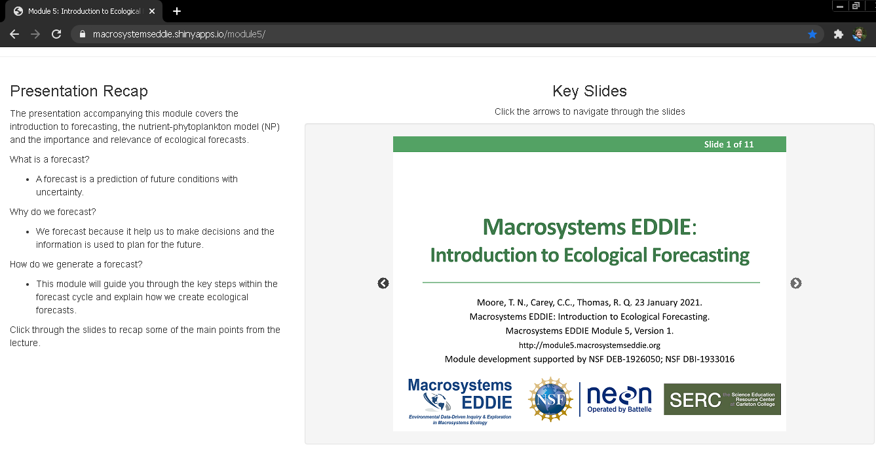
Navigate slides
Advance slides by clicking on the arrows

Slide 36
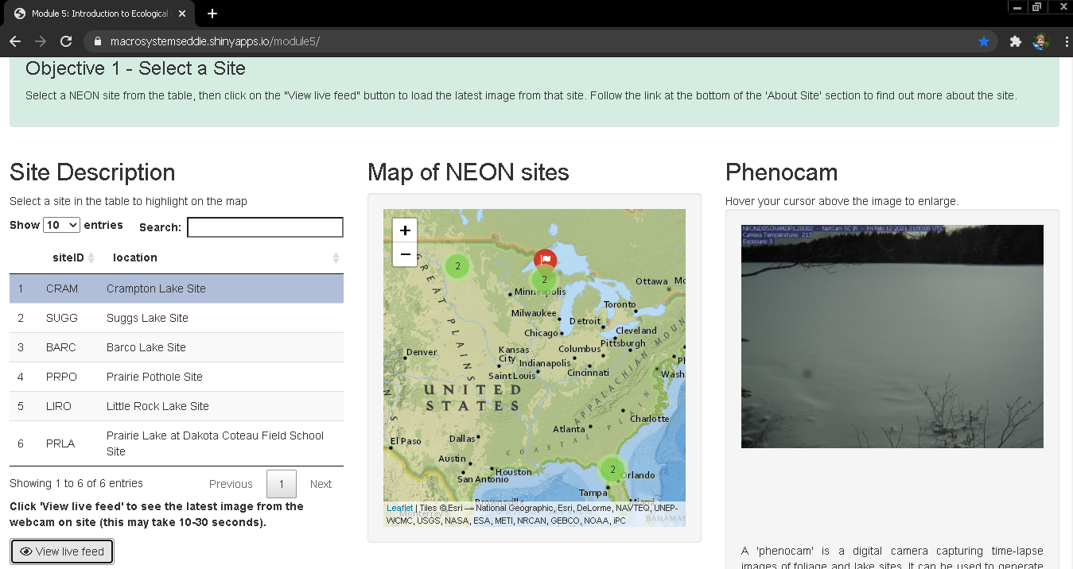
Interact with app
Select data table rows and click buttons

Slide 37
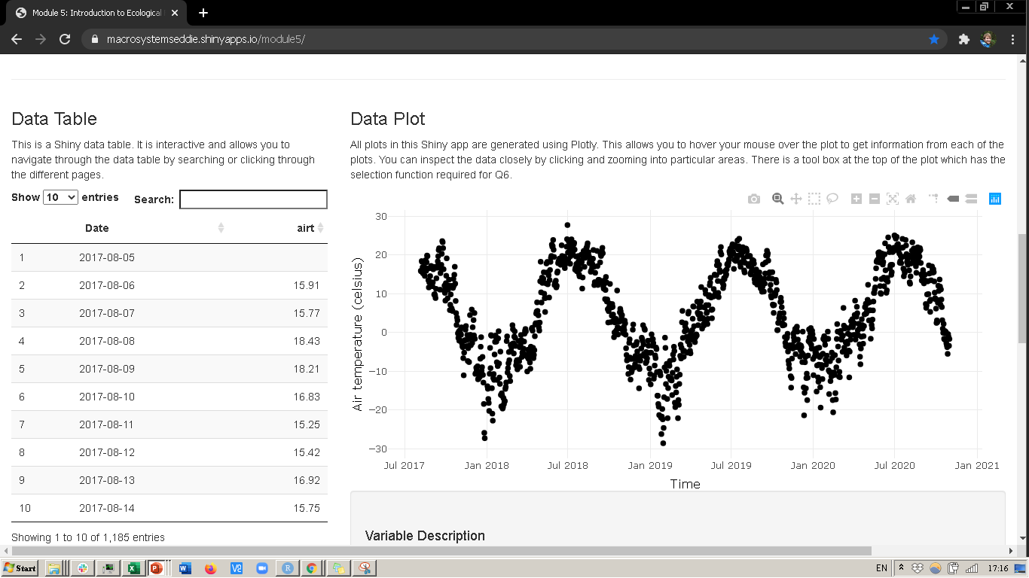
Interact with plots
Hover cursor over points or click and drag to zoom in
Hover cursor over plot to bring up options

Slide 38
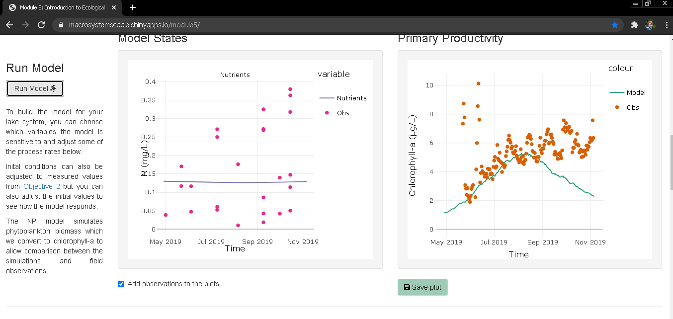
Saving plots
Save plots for downloading with your final report

Slide 39
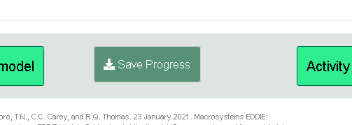
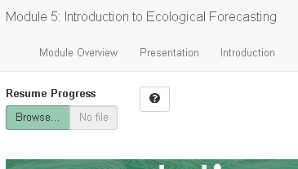
Saving & Resuming Progress
Saving Progress
Scroll to bottom of the page
Click on the “Save Progress” button. An ‘.eddie’ file will download. Your computer might prompt you to open this in R. This will not work, it only works for uploading to the Shiny app
Store this file somewhere safe on your computer
Resuming progress
Scroll to the top of the page
Upload the ‘.eddie’ file
This will populate your saved text answers and saved parameters

Slide 40
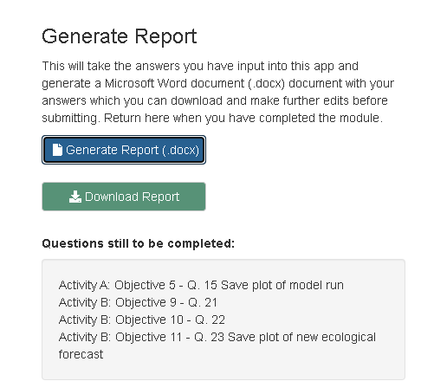
Downloading the Report
Navigate to the “Introduction” tab
Scroll down to “Save your progress” section
Click on the “Generate Report (.docx)” button.
Then the “Download Report” button will appear. Click this to download the report with answer and plots embedded within a Word document.
Notes:
Generating the student report.
Stop the presentation here and navigate to the Shiny App while screen sharing.
Briefly demonstrate how to navigate between Activity Tabs and objective tabs within each Activity.
Demonstrate the buttons regarding saving your progress and resuming your progress and the “Generate Report” feature.
Make sure to emphasize to students to read through the text carefully as there are instructions there if they get confused. Also encourage them to feel free to ask questions if they don’t understand what to do.
At this point send the students into breakout rooms of ~4 (2 pairs each) and let them get started on the Shiny App.
Identify if the saved report will be submitted as an assignment and which app questions need to be completed as part of the activity.

Slide 41
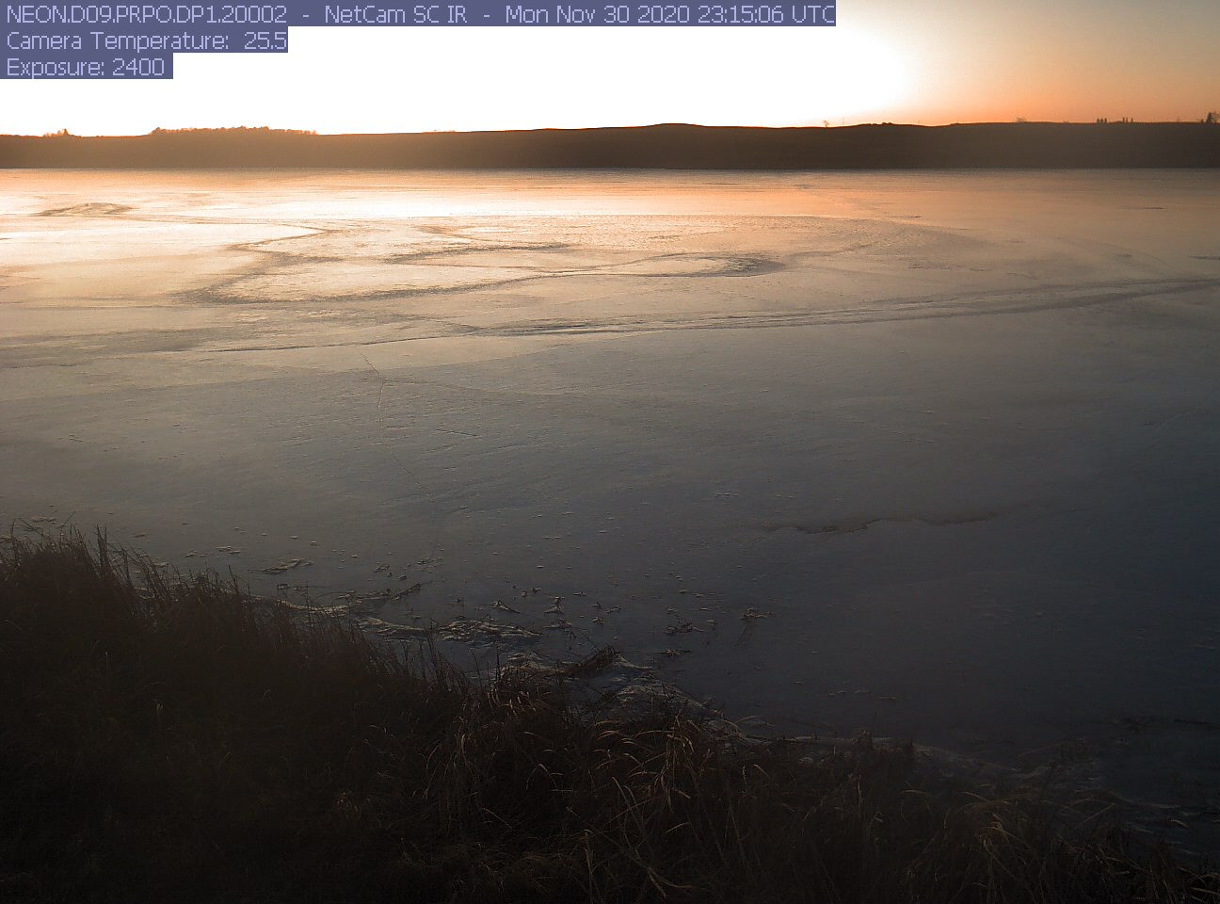
Thank you for participating!
If you’re interested in learning more, check out these modules:
Forecast Uncertainty
Improving Forecasts with Data
Using Forecasts to Guide Decision Making
Find out more at: macrosystemsEDDIE.org

Slide 43
Macrosystems EDDIE: Introduction to Ecological Forecasting continued…
Moore, T. N., Carey, C.C., Thomas, R. Q. 23 January 2021.
Macrosystems EDDIE: Introduction to Ecological Forecasting.
Macrosystems EDDIE Module 5, Version 1.
http://module5.macrosystemseddie.org
Module development supported by NSF DEB-1926050; NSF DBI-1933016
Notes:
Welcome the students to class.
It is really important at this point to emphasize that there will be lots of new material covered during this module, and that going slowly and asking for help is very much encouraged!

Slide 44
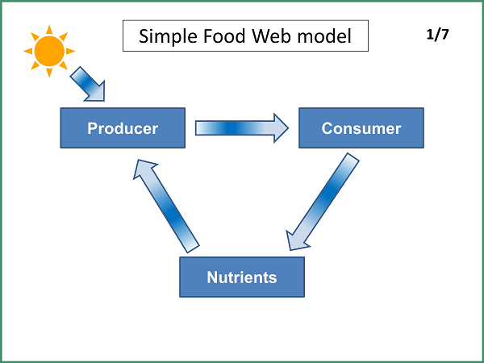
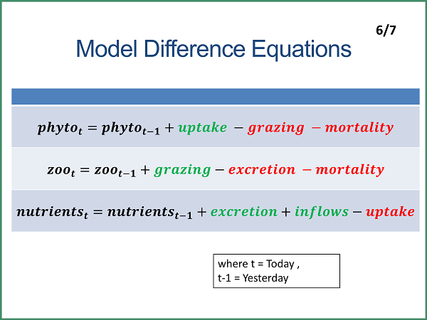
Models Primary Production in Lakes
Conceptual Model
Mathematical Model

Slide 45




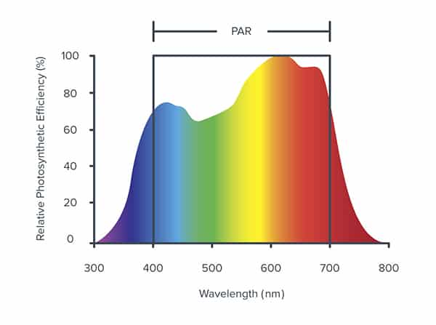
Model Components
Phytoplankton – are photosynthetic producers which convert energy into organic substance
Zooplankton – are secondary consumers and graze on microscopic algae like phytoplankton
Nutrients – in the water column are taken up by phytoplankton and converted to organic substances in the presence of sunlight
Photosynthetic Active Radiation (PAR) – is the the spectral range of solar radiation from 400 to 700 nm that photosynthetic organisms use in the process of photosynthesis
N

Slide 46
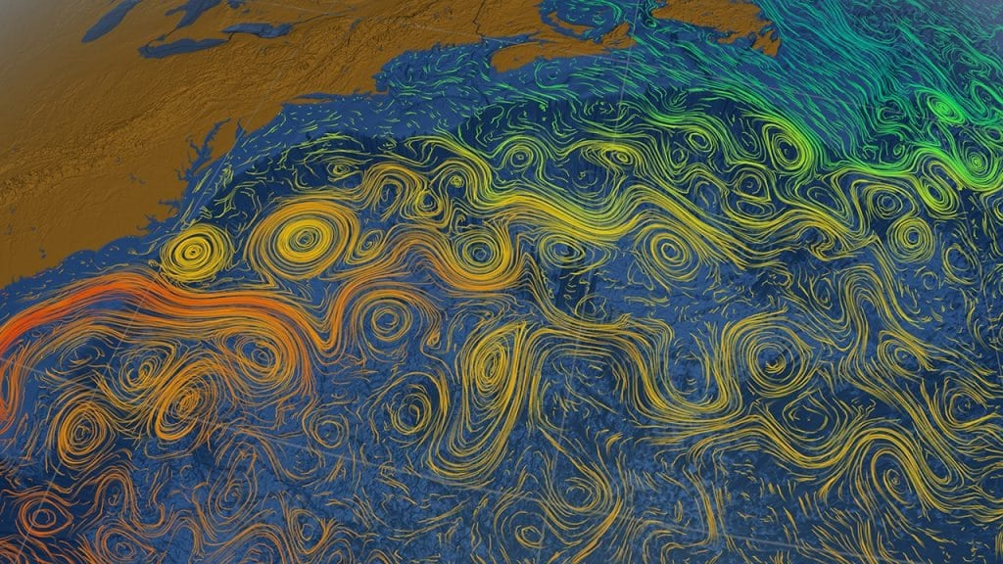
Observation
Model
Uncertainty
Driver
Initial conditions
Notes:
There are many sources of uncertainty that affect ecological forecasts. Here are the main identified ones.
Observation uncertainty – this is related to uncertainty around measurements made when collecting data.
Model – related to the uncertainty within an ecological model. Can be explained by Process - No matter how complex the model is, it will never truly represent the processes and Parameters - parameters are used within models to represent either approximations or inherent

Slide 47
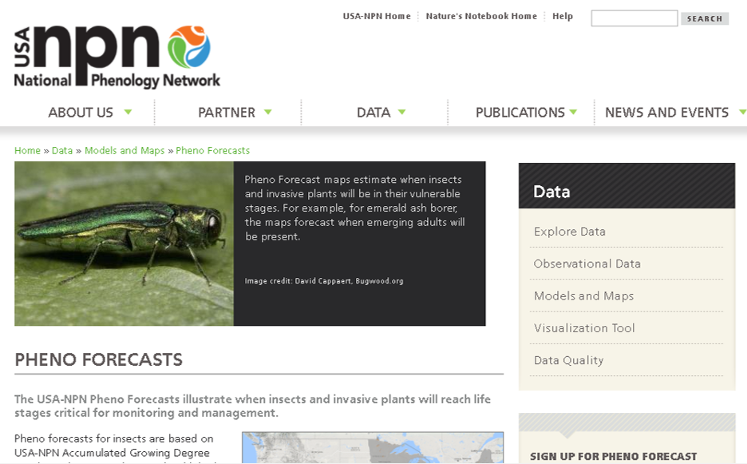
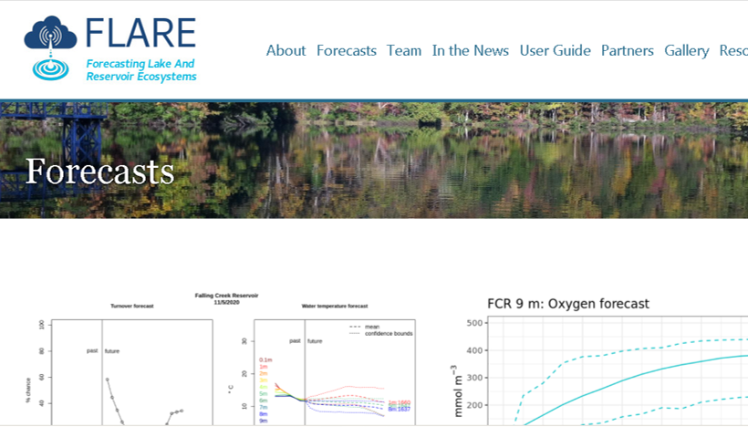
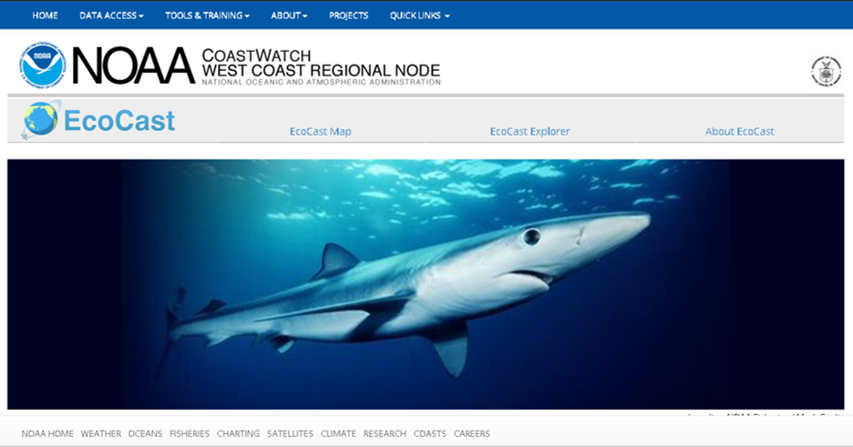
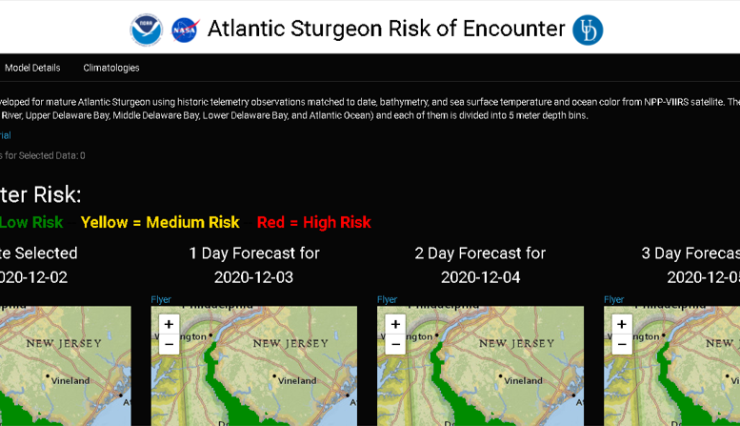
Ecological Forecast Examples
Short-term forecasts of phenological events in plants and pest insects.
Short-term forecasts of reservoir water quality for management of drinking water supply
Optimizing sustainable harvests of target fish while minimizing bycatch
Risk of encountering Atlantic Sturgeon in Chesapeake Bay
See Shiny app for more info…

Slide 48
What do you think are the key components of a forecast?
Data
Knowledge
Forecast
Uncertainty
Communication
Notes:
Using examples of forecasts that have been mentioned, encourage students to think of:
What is needed to create that forecast?
How is a forecast generated?
In what way is it presented to communicate the forecast?
Why is there uncertainty in a forecast?

Slide 49
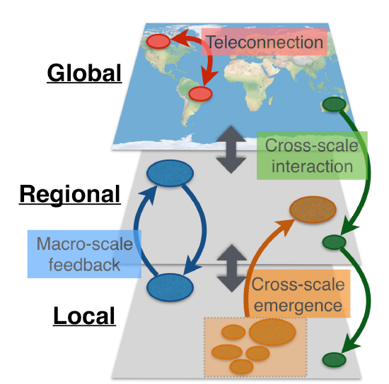
Ecological forecasting helps to understand macrosystems ecological interactions
Ecological forecasting can be used to test our understanding of ecosystem function
It can also inform the design of data collection at certain spatial and temporal scales
Macrosystems ecologists study ecological dynamics and feedbacks at multiple interacting spatial and temporal scales
Figure modified from: Heffernan et al. 2014
Notes:
A macrosystems ecology approach can be used to address ecological dynamics and feedbacks across multiple spatial and temporal scales.

Slide 50
Quantifying Uncertainty
Analyzing the sources of uncertainty can inform which measurements are critical to reduce uncertainty
Quantifying uncertainty can include:
Historical performance of models
Known variability in natural processes
Analysis of the data which is used to generate the forecast
Notes:
A forecast is a well-informed guess of the future; therefore, it will always be uncertain.
We can use mathematical methods to measure and constrain uncertainty within our forecast.

